Slide 1
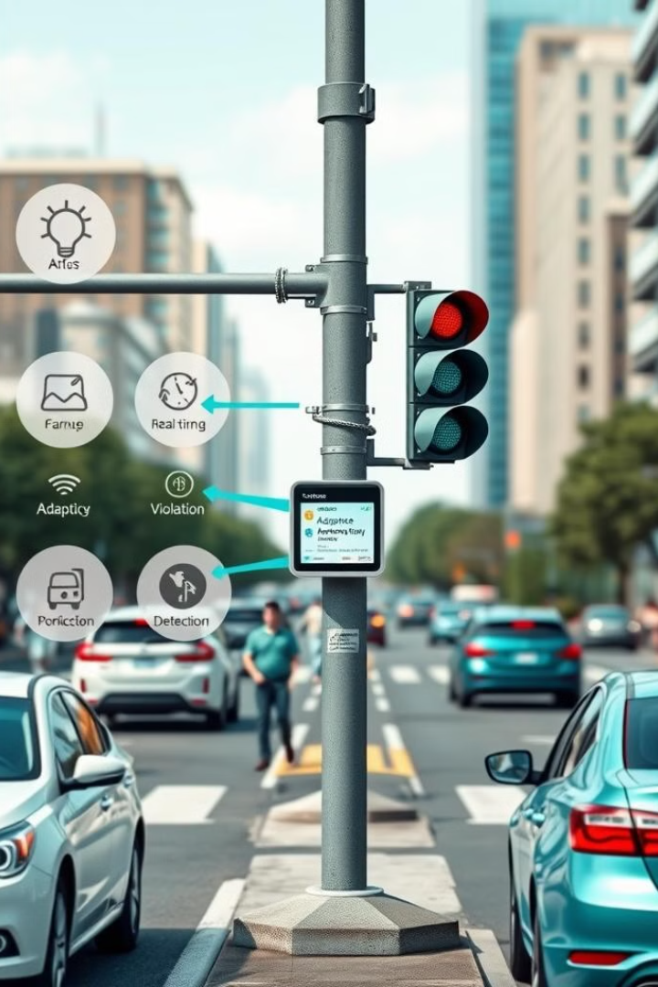
Traffic Management System
Welcome! This presentation covers an traffic management system.
It includes real-time monitoring, adaptive signal control, and violation detection. This enhances traffic flow and safety.
Notes:
1

Slide 2
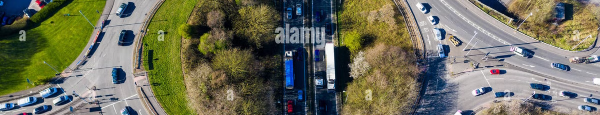
Smart Traffic System Objectives
Adaptive Traffic Control
Real-Time Monitoring
Automatic Violation Detection
Adjust signal timing based on current traffic density.
Provide live updates on traffic conditions for rapid response.
Identify and record vehicles that run red lights.
This system aims to optimize traffic flow and improve safety for all users.
Notes:
2

Slide 3

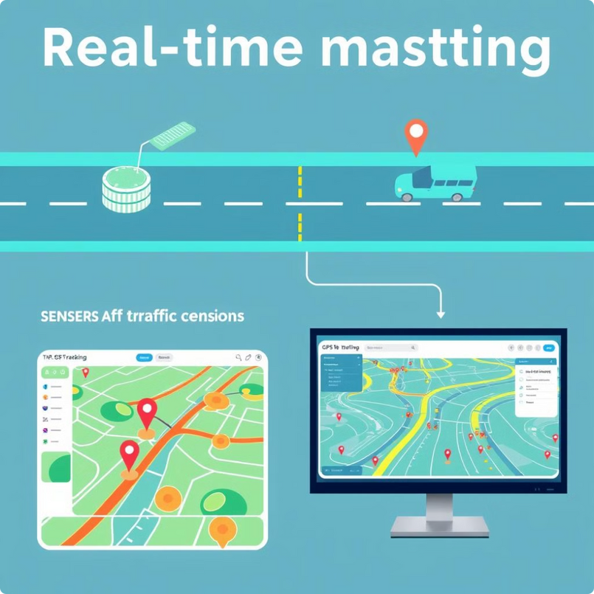



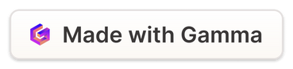
System's Key Features
Sensor Integration
Vehicle Tracking
Traffic Heatmaps
Real-time traffic monitoring uses sensor integration and vehicle tracking. Traffic heatmaps visually represent congestion levels. Dynamic signal control adapts timing and prioritizes traffic flow.
Notes:
3

Slide 4
Adaptive Signal Timing
High Traffic
Low Traffic
If traffic exceeds 50%, green light time increases. Red light time decreases.
Standard signal timing (30 seconds per light) is maintained.
Timing adjustments are based on real-time traffic density. This balances traffic flow and reduces congestion.
Notes:
4

Slide 5
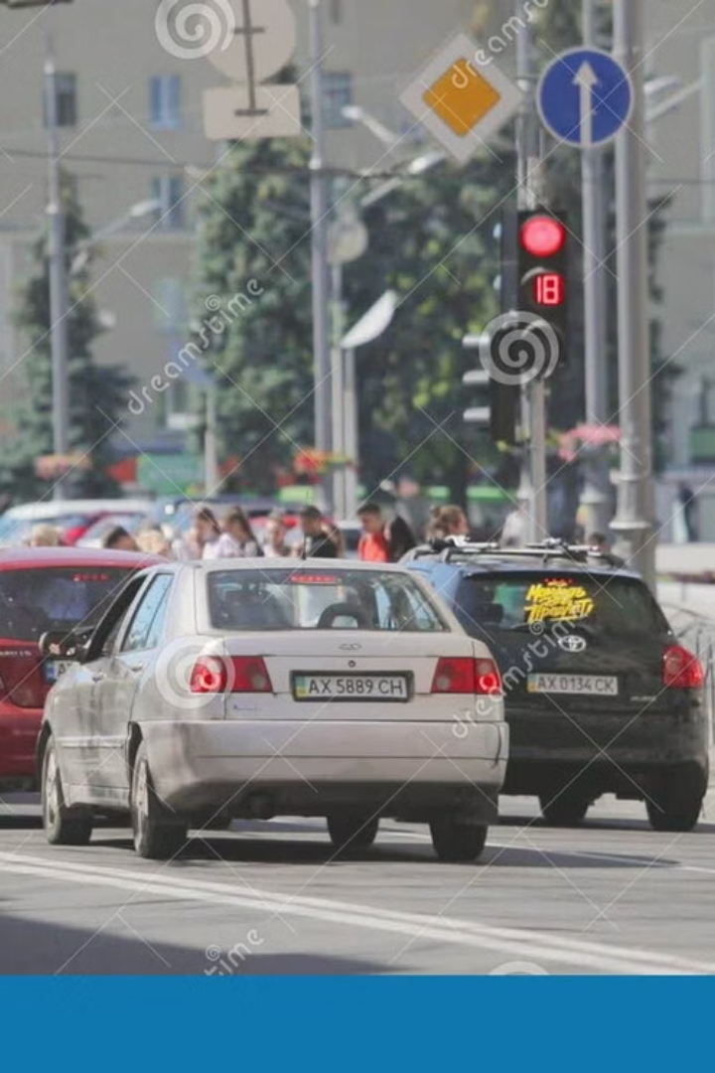



Understanding Traffic Signal Execution
Green Light
Vehicles proceed through the intersection.
Yellow Light
Drivers prepare to stop safely.
Red Light
Vehicles stop; pedestrians may cross.
Proper execution is critical for maintaining smooth traffic flow and pedestrian safety.
Notes:
5

Slide 6

Automated Violation Detection
Red Light Detection
Fine Issuance
System detects vehicles running red lights.
Automatic fine is issued to the violator.
This system enhances safety by discouraging dangerous driving behavior. It reduces accidents at intersections.
Notes:
6

Slide 7



Fine Issuing Procedure
1
$500 Fine
2
Automated
3
Database
Violators are automatically fined $500. Fines are recorded in an unordered_map database. This ensures efficient and accurate record keeping.
Notes:
7

Slide 8
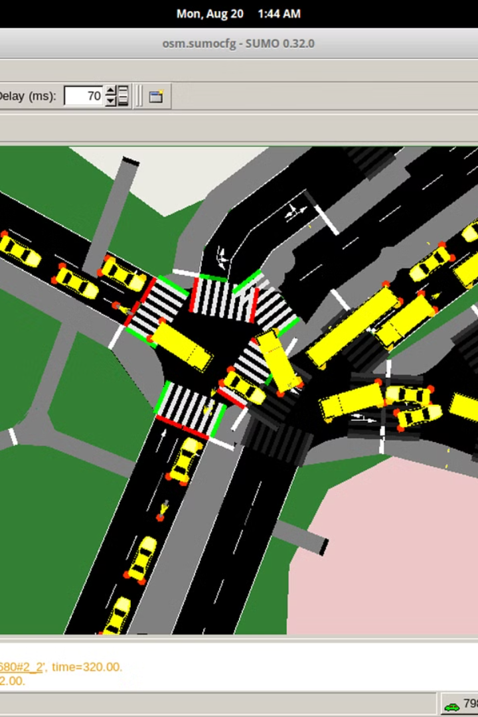
System Demonstration Overview
1
Traffic Density
User inputs traffic density (0-100).
2
Signal Adjustment
Signals adapt accordingly.
3
Simulation
Simulation runs for 2 minutes.
4
Fines Displayed
Fines are displayed at the end.
The demonstration shows real-time adjustments and fine tracking. This offers a clear picture of system performance.
Notes:
8

